Slide 1
Design and Analysis of Algorithms
Class 1

Slide 2
What is an algorithm?
An algorithm is a recipe or procedure or set of instructions to solve a problem

Slide 3
Why study algorithms?
#1
Algorithms are considered as the cornerstone of Computer Science

Slide 4
Examples of algorithms in Computer Science
Fast Fourier Transform
RSA
Diffie Hellman
Dijkstra
Bellman Ford
AES
Integer Factorization
Data Compression
Query Optimization
Apriori
DB Scan
Congestion Control
Naïve Bayes
Support Vector Machine
Linear Regression
SIFT
SURF
And many many many more …

Slide 5
Why study algorithms?
#2
Algorithms play a key role in modern technologies and innovations
Ex: Page Rank

Slide 6
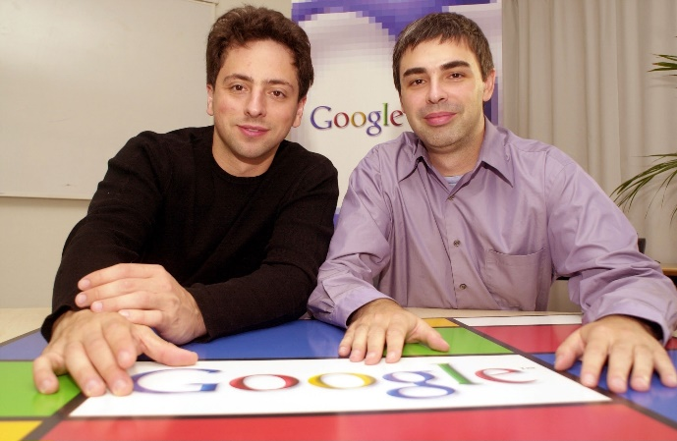
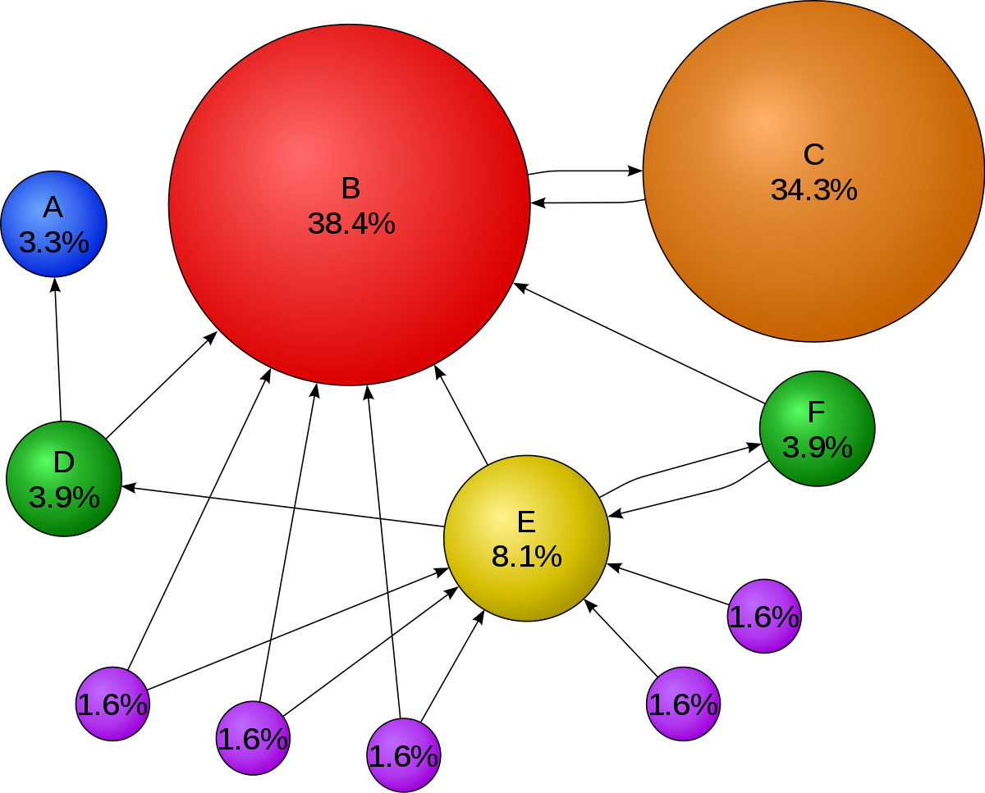

An algorithm that changed the world! Page Rank
+
=

Slide 7
Why study algorithms?
#3
Provides a novel lens on domains outside Computer Science as well
#4
Challenging and Fun! ☺

Slide 8
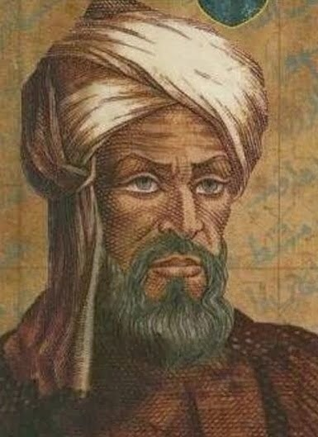
History of Algorithms
Father of Algorithms
Abu Abdullah Muhammad
ibn Musa Al-Khwarizmi (c. 850 AD).
Persian Astronomer and Mathematician

Slide 9
History of Algorithms
Al – Khwarizmi introduced the decimal positioning within numeric systems to the western world.
In its original form, algorithms known as algorism was regarded as rules for computing calculations and performing arithmetic with Hindu-Arabic numerals.

Slide 10
Design and Analysis of Algorithms

